Slide 1
JAVASCRIPT

Slide 2
JavaScript is a dynamic computer programming language.
It is lightweight and most commonly used as a part of web pages, whose implementations allow client-side script to interact with the user and make dynamic pages.

Slide 3
JavaScript can be implemented using JavaScript statements that are placed within the <script>... </script> HTML tags in a web page.
The <script> tag alerts the browser program to start interpreting all the text between these tags as a script. A simple syntax of your JavaScript will appear as follows.
<script>
javascript code
</script>
The script tag takes two important attributes −
Language − This attribute specifies what scripting language you are using. Typically, its value will be javascript.
Type − This attribute is what is now recommended to indicate the scripting language in use and its value should be set to "text/javascript".
<script language="javascript" type="text/javascript">
JavaScript code
</script>

Slide 4
Example of Javascript:
<html>
<body>
<script language="javascript“ type="text/javascript">
document.write("welcome to javascript");
</script>
</body>
</html>

Slide 5
VARIABLES:
Variables are the containers for storing information.
For example, assume you want to store two values 10 and 20 in your program and at a later stage, you want to use these two values. Let's see how you will do it. Here are the following three simple steps −
Create variables with appropriate names.
Store your values in those two variables.
Retrieve and use the stored values from the variables.
2. Javascript variables should be declare with the var statement
3. JavaScript variables are used to hold values or expressions.
4. Javascript variables are case sensitive.
5. Variable must begin with the letter.
eg: stu_name
stu_rollno
rollno

Slide 6
JavaScript DATATYPES
One of the most fundamental characteristics of a programming language is the set of data types it supports.
These are the type of values that can be represented and manipulated in a programming language.
data types:
Numbers: eg. 123, 120.50 etc.
Strings: of text e.g. "This text string" etc.
Boolean: e.g. true or false
Before you use a variable in a JavaScript program, you must declare it. Variables are declared with the var keyword as follows.
Example:
var money;
var name;
var money,name;
Storing a value in a variable is called variable initialization. You can do variable initialization at the time of variable creation or at a later point in time when you need that variable.
Example: name=“john”;
money=12;
or
var name=“john”;

Slide 7
What is an operator?
Let us take a simple expression 4 + 5 is equal to 9. Here 4 and 5 are called operands and ‘+’ is called the operator.
JavaScript supports the following types of operators.
Arithmetic Operators:
Operator | Description
+ | Addition
- | Subtraction
* | Multiplication
/ | Division
% | Modulus
++ | Increment
-- | Decrement

Slide 8
Example:
var x,y,z;
x = 5; y = 2; z = x + y;
Output:z=7
Example:
txt1 = "John"; txt2 = "Doe"; txt3 = txt1 + " " + txt2;
Output: John Doe

Slide 9
JavaScript Comparison Operators:
== | equal to
=== | equal value and equal type
!= | not equal
!== | not equal value or not equal type
> | greater than
< | less than
>= | greater than or equal to
<= | less than or equal to

Slide 10
JavaScript Logical Operators
Operator | Description
&& | logical and
|| | logical or
! | logical not

Slide 11
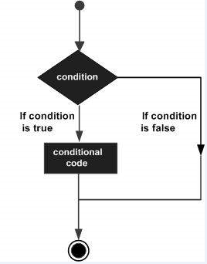
Control structures and looping:
While writing a program, there may be a situation when you need to adopt one out of a given set of paths.
In such cases, you need to use conditional statements that allow your program to make correct decisions
and perform right actions.
JavaScript supports conditional statements which are used to perform different actions based on different conditions.
1) if..else statement.

Slide 12
Example
Try the following example to understand how the if statement works.
<html>
<body>
<script type="text/javascript">
var age = 20;
if( age > 18 )
{
document.write("<b>Qualifies for driving</b>");
}
</script>
<p>Set the variable to different value and then try...</p>
</body>
</html>

Slide 13
Example
Try the following code to learn how to implement an if-else statement in JavaScript.
<html>
<body>
<script type="text/javascript">
var age = 20;
if( age > 18 ){
document.write("<b>Qualifies for driving</b>");
}
else{
document.write("<b>Does not qualify for driving</b>");
}
</script>
<p>Set the variable to different value and then try...</p>
</body>
</html>

Slide 14
Example
Try the following code to learn how to implement an if-else-if statement in JavaScript.
<script type="text/javascript">
var book = "maths";
if( book == "history" ){
document.write("<b>History Book</b>");
}
else if( book == "maths" ){
document.write("<b>Maths Book</b>");
}
else if( book == "economics" ){
document.write("<b>Economics Book</b>");
}
else{
document.write("<b>Unknown Book</b>");
}
</script>

Slide 15
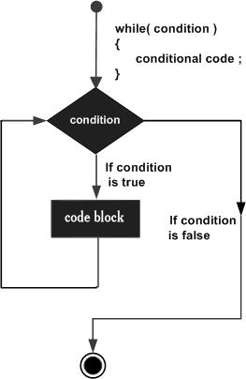
The while Loop:
The purpose of a while loop is to execute a statement or code block repeatedly as long as an expression is true. Once the expression becomes false, the loop terminates.
while (expression){
Statement(s) to be executed if expression is true
}

Slide 16
Example:
<html>
<body>
<script type="text/javascript">
var count = 0;
document.write("Starting Loop ");
while (count < 10)
{
document.write("Current Count : " + count + "<br />");
count++;
}
document.write("Loop stopped!");
</script>
<p>Set the variable to different value and then try...</p>
</body>
</html>

Slide 17
OUTPUT:
Starting Loop Current Count : 0 Current Count : 1 Current Count : 2 Current Count : 3 Current Count : 4 Current Count : 5 Current Count : 6 Current Count : 7 Current Count : 8 Current Count : 9 Loop stopped!Set the variable to different value and then try...

Slide 18
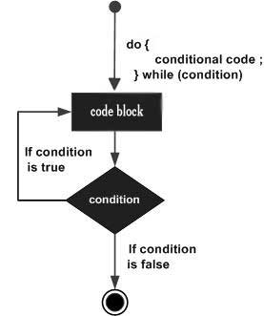
The do...while Loop:
The do...while loop is similar to the while loop except that the condition check happens at the end of the loop.
This means that the loop will always be executed at least once, even if the condition is false.
do{
Statement(s) to be executed;
}
while (expression);

Slide 19
<html>
<body>
<script type="text/javascript">
var count = 0;
document.write("Starting Loop" + "<br />");
do{
document.write("Current Count : " + count + "<br />");
count++;
}
while (count < 5);
document.write ("Loop stopped!");
</script>
<p>Set the variable to different value and then try...</p>
</body>
</html>

Slide 20
Starting Loop
Current Count : 0
Current Count : 1
Current Count : 2
Current Count : 3
Current Count : 4
Loop Stopped!
Set the variable to different value and then try...

Slide 21
FOR LOOP:
The 'for' loop is the most compact form of looping. It includes the following three important parts −
The loop initialization where we initialize our counter to a starting value. The initialization statement is executed before the loop begins.
The test statement which will test if a given condition is true or not. If the condition is true, then the code given inside the loop will be executed, otherwise the control will come out of the loop.
The iteration statement where you can increase or decrease your counter.

Slide 22
<html>
<body>
<script type="text/javascript">
var count;
document.write("Starting Loop" + "<br />");
for(count = 0; count < 10; count++)
{
document.write("Current Count : " + count );
document.write("<br />");
}
document.write("Loop stopped!");
</script>
<p>Set the variable to different value and then try...</p>
</body>
</html>

Slide 23
OUTPUT:
Starting Loop
Current Count : 0
Current Count : 1
Current Count : 2
Current Count : 3
Current Count : 4
Current Count : 5
Current Count : 6
Current Count : 7
Current Count : 8
Current Count : 9
Loop stopped!
Set the variable to different value and then try...

Slide 24
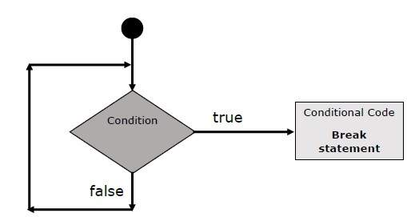
The break Statement:
JavaScript provides full control to handle loops. There may be a situation when you need to come out of a loop without reaching its bottom. There may also be a situation when you want to skip a part of your code block and start the next iteration of the loop.
To handle all such situations, JavaScript provides break and continuestatements. These statements are used to immediately come out of any loop or to start the next iteration of any loop respectively.
The break Statement

Slide 25
Example:
<html>
<body>
<script type="text/javascript">
var x = 1;
document.write("Entering the loop<br /> ");
while (x < 20)
{
if (x == 5){
break; // breaks out of loop completely
}
x = x + 1;
document.write( x + "<br />");
}
document.write("Exiting the loop!<br /> ");
</script>
<p>Set the variable to different value and then try...</p>
</body>
</html>

Slide 26
OUTPUT:
Entering the loop 2 3 4 5 Exiting the loop! Set the variable to different value and then try...

Slide 27
The continue Statement
The continue statement breaks one iteration (in the loop) if a specified condition occurs, and continues with the next iteration in the loop.
The difference between continue and the break statement, is instead of "jumping out" of a loop, the continue statement "jumps over" one iteration in the loop.

Slide 28
<html>
<body>
<script type="text/javascript">
var x = 1;
document.write("Entering the loop<br /> ");
while (x < 10)
{
x = x + 1;
if (x == 5){
continue; // skip rest of the loop body
}
document.write( x + "<br />");
}
document.write("Exiting the loop!<br /> ");
</script>
<p>Set the variable to different value and then try...</p>
</body>
</html>

Slide 29
OUTPUT:
Entering the loop 2 3 4 6 7 8 9 10 Exiting the loop! Set the variable to different value and then try...

Slide 30
JavaScript - Functions
A function is a group of reusable code which can be called anywhere in your program. This eliminates the need of writing the same code again and again. It helps programmers in writing modular codes. Functions allow a programmer to divide a big program into a number of small and manageable functions.
Function Definition
Before we use a function, we need to define it. The most common way to define a function in JavaScript is by using the function keyword, followed by a unique function name, a list of parameters (that might be empty), and a statement block surrounded by curly braces.

Slide 31
Syntax:
<script type="text/javascript">
function functionname(parameter-list)
{
statements
}
</script>
Example:
<script type="text/javascript">
function sayHello()
{
alert("Hello there");
}
</script>

Slide 32
Calling a Function:
<html>
<head>
<script type="text/javascript">
function sayHello()
{
document.write ("Hello there!");
}
</script>
</head>
<body>
<p>Click the following button to call the function</p>
<form>
<input type="button" onclick="sayHello()" value="Say Hello">
</form>
<p>Use different text in write method and then try...</p>
</body>
</html>

Slide 33
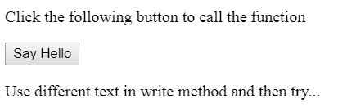

OUTPUT:
Click on Say Hello button

Slide 34
Function Parameters
Till now, we have seen functions without parameters. But there is a facility to pass different parameters while calling a function.
These passed parameters can be captured inside the function and any manipulation can be done over those parameters.
A function can take multiple parameters separated by comma.

Slide 35
Example:
<html>
<head>
<script type="text/javascript">
function sayHello(name, age)
{
document.write (name + " is " + age + " years old.");
}
</script>
</head>
<body>
<p>Click the following button to call the function</p>
<form>
<input type="button" onclick="sayHello('Zara', 7)" value="Say Hello">
</form>
<p>Use different parameters inside the function and then try...</p>
</body>
</html>

Slide 36
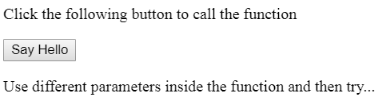
OUTPUT:
Click on Say Hello button
Zara is 7 years old.

Slide 37
The return Statement
A JavaScript function can have an optional return statement. This is required if you want to return a value from a function.
This statement should be the last statement in a function.

Slide 38
<head>
<script type="text/javascript">
function concatenate(first, last)
{
var full;
full = first + last;
return full;
}
function secondFunction()
{
var result;
result = concatenate('Zara', 'Ali');
document.write (result );
}
</script>
</head>
<body>
<p>Click the following button to call the function</p>
<form>
<input type="button" onclick="secondFunction()" value="Call Function">
</form>
<p>Use different parameters inside the function and then try...</p>
</body>

Slide 39
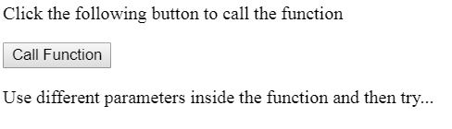
OUTPUT:
Click on Say Hello button
ZaraAli
1) Write a program to add two numbers using function.

Slide 40
Dialog Box
JavaScript supports three important types of dialog boxes. These dialog boxes can be used to raise and alert, or to get confirmation on any input or to have a kind of input from the users.
Alert Dialog Box
An alert dialog box is mostly used to give a warning message to the users. For example, if one input field requires to enter some text but the user does not provide any input, then as a part of validation, you can use an alert box to give a warning message.
A confirmation dialog box
is mostly used to take user's consent on any option. It displays a dialog box with two buttons: Cancel and Ok
If the user clicks on the OK button, the window method confirm() will return true. If the user clicks on the Cancel button, then confirm() returns false. You can use a confirmation dialog box as follows.

Slide 41
The prompt dialog box
is very useful when you want to pop-up a text box to get user input. Thus, it enables you to interact with the user. The user needs to fill in the field and then click OK.
This dialog box is displayed using a method called prompt() which takes two parameters: (i) a label which you want to display in the text box and (ii) a default string to display in the text box.
This dialog box has two buttons: OK and Cancel. If the user clicks the OK button, the window method prompt() will return the entered value from the text box. If the user clicks the Cancel button, the window method prompt()returns null.

Slide 42
Alert Dialog Box
<html>
<head>
<script type="text/javascript">
function Warn() {
alert ("This is a warning message!");
document.write ("This is a warning message!");
}
</script>
</head>
<body>
<p>Click the following button to see the result: </p>
<form>
<input type="button" value="Click Me" onclick="Warn();" />
</form>
</body>
</html>

Slide 43
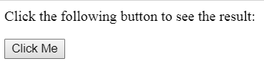
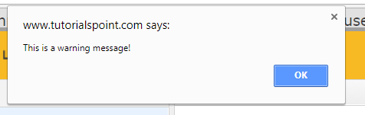
OUTPUT:
This is a warning message!

Slide 44
A confirmation dialog box
<html>
<head>
<script type="text/javascript">
function getConfirmation(){
var retVal = confirm("Do you want to continue ?");
if( retVal == true ){
document.write ("User wants to continue!");
return true;
}
else{
document.write ("User does not want to continue!");
return false;
}
}
</script>
</head>
<body>
<p>Click the following button to see the result: </p>
<form>
<input type="button" value="Click Me" onclick="getConfirmation();" />
</form>
</body></html>

Slide 45
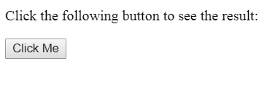
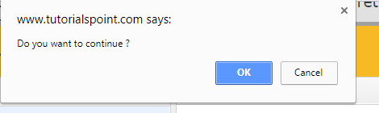

Slide 46
Prompt Dialog Box
<html>
<head>
<script type="text/javascript">
function getValue(){
var retVal = prompt("Enter your name : ", "your name here");
document.write("You have entered : " + retVal);
}
</script>
</head>
<body>
<p>Click the following button to see the result: </p>
<form>
<input type="button" value="Click Me" onclick="getValue();" />
</form>
</body>
</html>

Slide 47
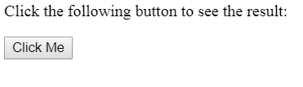
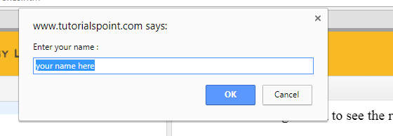

Slide 48
Example of ALERT BOX:
<html>
<head>
<script type="text/javascript">
function add()
{
a=10;
b=20;
c=a+b;
alert(c);
}
</script>
</head>
<body>
<form>
<input type="button" value="click me" onclick="add();">
</form>
</body>
</html>

Slide 49
GetElementById()
The getElementById() method returns the element that has the ID attribute with the specified value.
This method is one of the most common methods in the HTML DOM, and is used almost every time you want to manipulate, or get info from, an element on your document.
Returns null if no elements with the specified ID exists.
An ID should be unique within a page.

Slide 50
To find cube of given number from text box
<html>
<body>
<script type="text/javascript">
function getcube(){
var number1=document.getElementById("number").value;
alert(number1*number1*number1);
}
</script>
<form>
Enter No:<input type="text" id="number" name="number1"/><br/>
<input type="button" value="cube" onclick="getcube()"/>
</form>
</body>
</html>

Slide 51
To display text box values:
<html>
<body>
<form>
Name: <input type="text" id="Text1">
Surname: <input type="text" id="Text2">
full name:<input type="text" id="Text3">
<p>click on button to check name and surname </p>
<button onclick="myFunction();">Try it</button>
</form>
<script>
function myFunction() {
a=document.getElementById("Text1").value;
b=document.getElementById("Text2").value;
c=a+b;
//alert("full name is : " +a+ " " +b);
document.getElementById("Text3").value=c;
}
</script>
</body>
</html>

Slide 52
ADDITION OF TWO NUMBERS:
<html>
<body>
<form>
Num1: <input type="text" id="Text1">
Num2: <input type="text" id="Text2">
<p>Click the button for addition.</p>
<button onclick="myFunction()">Try it</button>
</form>
<script>
function myFunction() {
a = parseInt(document.getElementById("Text1").value);
b = parseInt(document.getElementById("Text2").value);
c = a+b;
document.write("addition of num1 and num is : " +c);
}
</script>
</body>
</html>

Slide 53
Write a program to print addition and subtraction using text boxes:
<html>
<head>
<body>
<script>
function add()
{
a = parseInt(document.getElementById("Text1").value);
b = parseInt(document.getElementById("Text2").value);
c = a+b;
document.getElementById("Text3").value = c;
}
function sub() {
a = parseInt(document.getElementById("Text1").value);
b = parseInt(document.getElementById("Text2").value);
c = a-b;
document.getElementById("Text4").value = c;
}
</script>
continue..

Slide 54
<form>
Num1: <input type="text" id="Text1">
Num2: <input type="text" id="Text2">
add: <input type="text" id="Text3">
sub :<input type="text" id="Text4">
<p>Click the button for addition.</p>
<button type="button" onclick="add();">addition</button>
<button type="button" onclick="sub();">sub</button>
</form>
</head>
</body>
</html>

Slide 55
<html>
<script>
function chgclr(color)
{
document.body.bgColor=color;
// in bgcolor C is capital
}
</script>
<body>
<h3> program to change background color using button </h3>
<input type="button" value="red" onclick="chgclr('red');">
<input type="button" value="green" onclick="chgclr('green');">
<input type="button" value="blue" onclick="chgclr('blue');">
</body>
</html>

Slide 56
Increment number by 1 using onclick event:
<script type="text/javascript">
var index = 0;
function increment(var1)
{
document.getElementById("t1").value=index;
index++;
}
</script>
<input type="button" id="button1" onclick="increment(1)" value="increment me!"/>
<input type="text" id="t1">

Slide 57
innerHTML:
The innerHTML property can be used to write the dynamic html on the html document.
It is used mostly in the web pages to generate the dynamic html such as registration form, comment form, links etc.
Example1:
<html>
<body>
<script>
function myFunction()
{
document.getElementById("demo").innerHTML = "Paragraph changed!";
}
</script>
<p id="demo" onclick="myFunction()">Click me to change my HTML content (innerHTML).</p>
</body>
</html>

Slide 58
Example2:
<html>
<script>
function abc()
{
document.getElementById("p1").innerHTML = "CSE/IT departments";
}
</script>
<body>
<h3 id="p1"> welcome to SBMP </h3>
<input type="button" value="click" onclick="abc();">
</body>
</html>

Slide 59
String - length Property:
The length property returns the length of a string (number of characters).
The length of an empty string is 0.
It will count the whitespaces.
<html>
<body>
<script>
var str = "this is text";
var n = str.length;
document.write("length is :" +n);
</script>
</body>
</html>

Slide 60
Style Object:
Syntax:element.style.property
Example1:
<html>
<body>
<h1 id="myH1">How to change the style of a header</h1>
<p>Click the button to change the style of the H1 element.</p>
<button onclick="myFunction()">Try it</button>
<script>
function myFunction() {
document.getElementById("myH1").style.color = "red";
}
</script>
</body>
</html>

Slide 61
Style background:
Example 3
<html>
<body>
<h1>Hello World!</h1>
<button type="button" onclick="myFunction();">Set background color</button>
<script>
function myFunction() {
document.body.style.backgroundColor = "red";
}
</script>
</body>
</html>

Slide 62
Mouseover and mouseout event(In HTML):
<html>
<head>
<script type="text/javascript">
function over()
{
document.getElementById("t").style.visibility="hidden";
}
function out()
{
document.getElementById("t").style.visibility="visible";
}
</script>
</head>
<body>
<pre id="t" onmouseover="over()" onmouseout="out()"> hiiiiiiiiiiiii</pre>
</body>
</html>

Slide 63
Mouseover and mouseout event(In Javascript):
<html>
<body>
<p>This example uses the HTML DOM to assign an "onmouseover" and "onmouseout" event to a h1 element.</p>
<h1 id="demo">Mouse over me</h1>
<script>
document.getElementById("demo").onmouseover = function() {mouseOver()};
document.getElementById("demo").onmouseout = function() {mouseOut()};
function mouseOver() {
document.getElementById("demo").style.color = "red";
}
function mouseOut() {
document.getElementById("demo").style.color = "black";
}
</script>
</body>
</html>

Slide 64
Onblur event:
The onblur event occurs when an object loses focus.
The onblur event is most often used with form validation code (e.g. when the user leaves a form field).
Example:
<html>
<body>
Enter your name: <input type="text" id="fname" onblur="myFunction()">
<p>When you leave the input field, a function is triggered which transforms the input text to upper case.</p>
<script>
function myFunction() {
var x = document.getElementById("fname").value;
y = x.toUpperCase();
document.getElementById("fname").value=y;
}
</script>
</body>
</html>

Slide 65
Onfocus:
The onfocus event occurs when an element gets focus
The onfocus event is the opposite of the onblur event.
<html>
<body>
Enter your name: <input type="text" id="myInput" onfocus="focusFunction()">
<script>
function focusFunction()
{
// Focus = Changes the background color of input to yellow
document.getElementById("myInput").style.background = "yellow";
}
</script>
</body>
</html>

Slide 66
Onfocus - onblurr event
<html>
<body>
Enter your name: <input type="text" id="myInput" onfocus="focusFunction()" onblur="blurFunction()">
<script>
function focusFunction() {
// Focus = Changes the background color of input to yellow
document.getElementById("myInput").style.background = "yellow";
}
function blurFunction() {
// No focus = Changes the background color of input to red
document.getElementById("myInput").style.background = "red";
}
</script>
</body>
</html>

Slide 67
onsubmit event
The onsubmit event occurs when a form is submitted.
<html>
<body>
<p>When you submit the form, a function is triggered which alerts some text.</p>
<form onsubmit="myFunction()">
Enter name: <input type="text" name="fname">
<input type="submit" value="Submit">
</form>
<script>
function myFunction() {
alert("The form was submitted");
}
</script>
</body>
</html>

Slide 68
onreset event
The onreset event occurs when a form is reset.
<html>
<body>
<p>When you reset the form, a function is triggered which alerts some text.</p>
<form onreset="myFunction()">
Enter name: <input type="text">
<input type="reset">
</form>
<script>
function myFunction() {
alert("The form was reset");
}
</script>
</body>
</html>

Slide 69
onselect Event
The onselect event occurs after some text has been selected in an element.
The onselect event is mostly used on <input type="text"> or <textarea> elements.
<html>
<body>
Select some of the text: <input type="text" value="Hello world!" onselect="myFunction()">
<script>
function myFunction()
{
alert("You selected some text!");
}
</script>
</body>
</html>

Slide 70
FORM VALIDATION USING FORM NAME.
<script>
function validateform(){
var name=document.myform.name.value;
var password=document.myform.password.value;
if (name=="")
{ alert("Name can't be blank");
return false; }
else if(password.length<6)
{ alert("Password must be at least 6 characters long.");
return false;
}
}
</script>
<body>
<form name="myform" method="get" action="hi.html" onsubmit="return validateform()">
Name: <input type="text" name="name"><br/>
Password: <input type="password" name="password"><br/>
<input type="submit" value="register">
</form>
</body>

Slide 71
FORM VALIDATION USING getElementById() method
<script>
function validateform(){
var name1=document.getElementById("t1").value;
if (name1=="")
{
alert("enter valid");
}
else
{
alert("successfull");
}}
</script>
<body>
<form name="myform" method="post" >
Name: <input type="text" id="t1"><br/>
<input type="submit" value="register" onclick="validateform()">
</form>
</body>

